Slide 1

HEALTH INSURANCE PREMIUM PREDICITON
-BY AISHWARYA MATE

Slide 2
OBJECTIVE:
BENEFITS:
The main objective of this project is to build a model which will predict the yearly health insurance premium for a person based on some health data.
1.This will give an idea of how much a person will have to pay for his/her premium.
2.Help to a person to focus on health aspect.
3.Easy to manage.
4.Person can get predicted premium value quickly.
5.Help company to automate the work for predicting premium to their customers

Slide 3
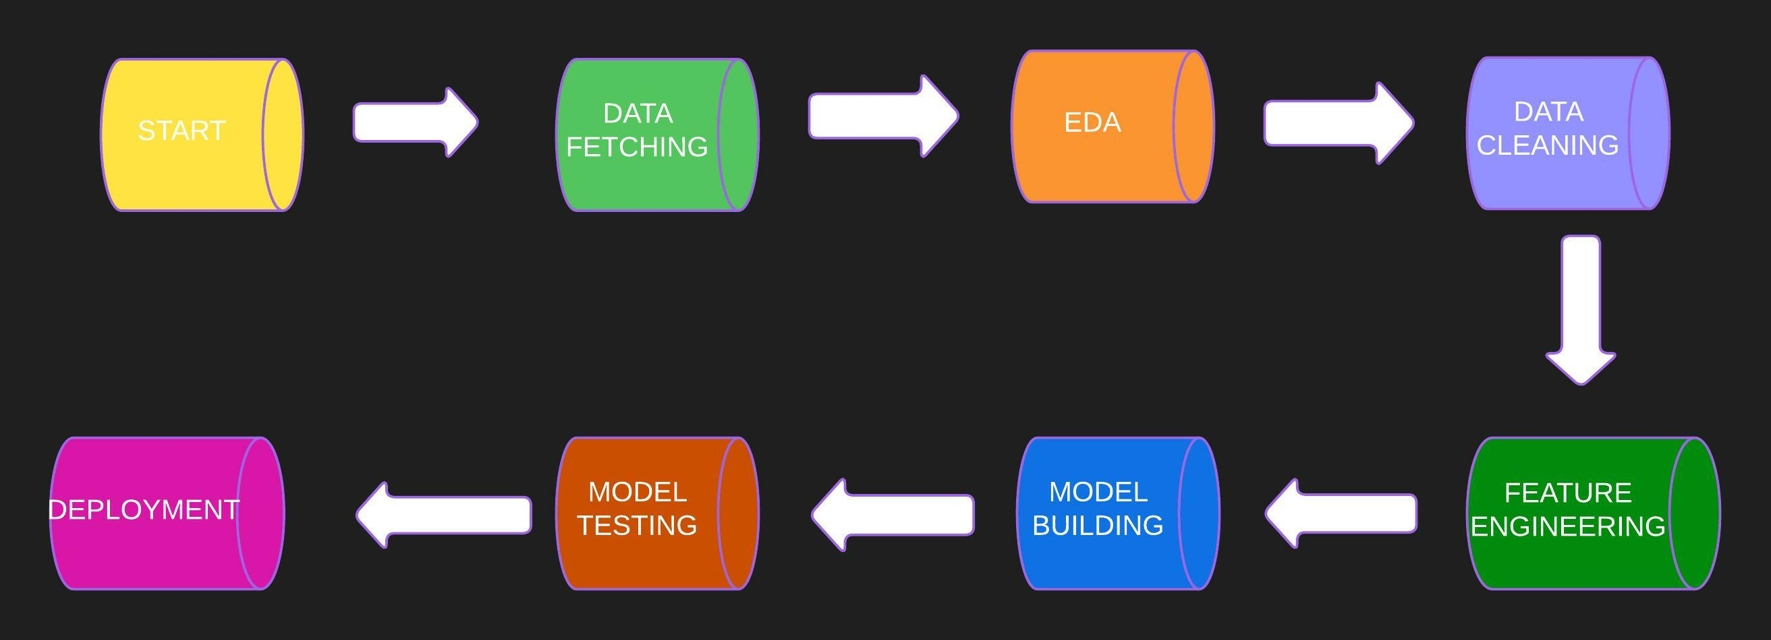
ARCHITECHTURE

Slide 4
DATA COLLECTION AND VALIDATION
This dataset is collected from Kaggle website.
Data type : Checked the data types for all the columns present in the data.
Data cleaning : Checked presence of null values and duplicated values.

Slide 5
MODEL TRAINING
DATA PREPROSESSING:
EDA is performed to clean the data and to get insights from the dataset to understand it clearly.
Checked from null, duplicate values, if any found, they are handled.
Visualization is done to get better insights and understanding of the data.
Encoding of categorical features into numerical features.
Performed standardization on the dataset.
Training model:
After EDA, the data is trained on multiple algorithms.
Various algorithms are used to select the best one.

Slide 6
MODEL SELECTION
After the data pre-processing part, the data is trained on multiple algorithms like:
Linear Regression
Decision Tree
Random Forest
KNN
Gradient Boosting
After training data on above algorithms, we calculated the accuracy for each model and selected the model which gave highest accuracy.
In our case, Gradient boosting model gave the highest accuracy, so has been selected as a final model.

Slide 7
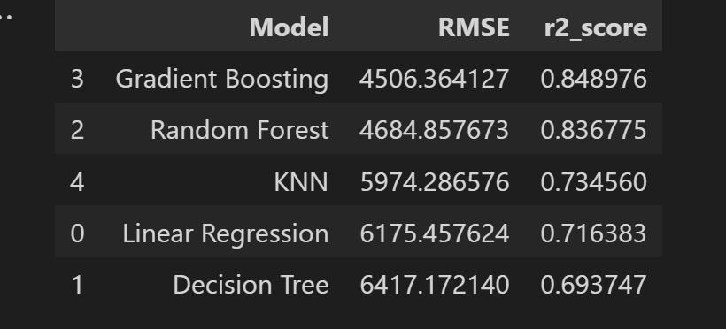
PREDICTIONS
All the model were used for validating the test set.
Calculated the RMSE and r2 score for each and every model created.
Accuracy given by every model is as follows :

Slide 8
Q and A:
What is source of data?
Data is collected from Kaggle. The data is present in csv format.
2) What was the type of data?
The data is combination of numerical and categorical values.
3)What is the complete flow you followed for project?
- Refer to the slide 3 for better understanding
4) What techniques were you using for data pre-processing?
Visualizing relation of independent variables with each other and output variables
Cleaning data and imputing if null values are present.
Checking Distribution of continuous values
Converting categorical data into numeric values.
Scaling the data

Slide 9
5) How training was done or what models were used?
Before training the model, data was divided into training and testing set.
5 algorithms are used to train the model.
These 5 algorithms are as follows:
Linear regression
Decision Tree
Random Forest
KNN
Gradient Boosting
Checked the accuracy, Gradient boosting algorithm is selected.
6) How prediction was done?
-On the basis of trained model, the prediction was done.
7) What are the different stages of deployment?
-Created API interface using streamlit.
- Model is deployed on Heroku platform.

